Slide 1
Dragonfly - Make Image Distribution
Efficiently and Safely
Tao Peng, Ant Group
Yuxing Liu, Alibaba Cloud

Slide 2
Arch
01
03
Agenda
02
Intro
Nydus Image Service

Slide 3
PART ONE
Intro
01

Slide 4
What is Dragonfly
Dragonfly is an open source intelligent P2P based image and file distribution system.
Its goal is to tackle all distribution problems in cloud native scenarios.
The core objectives of Dragonfly：
Improve download efficiency at large scale
Reduce the pressure of source server & save costly bandwidth

Slide 5
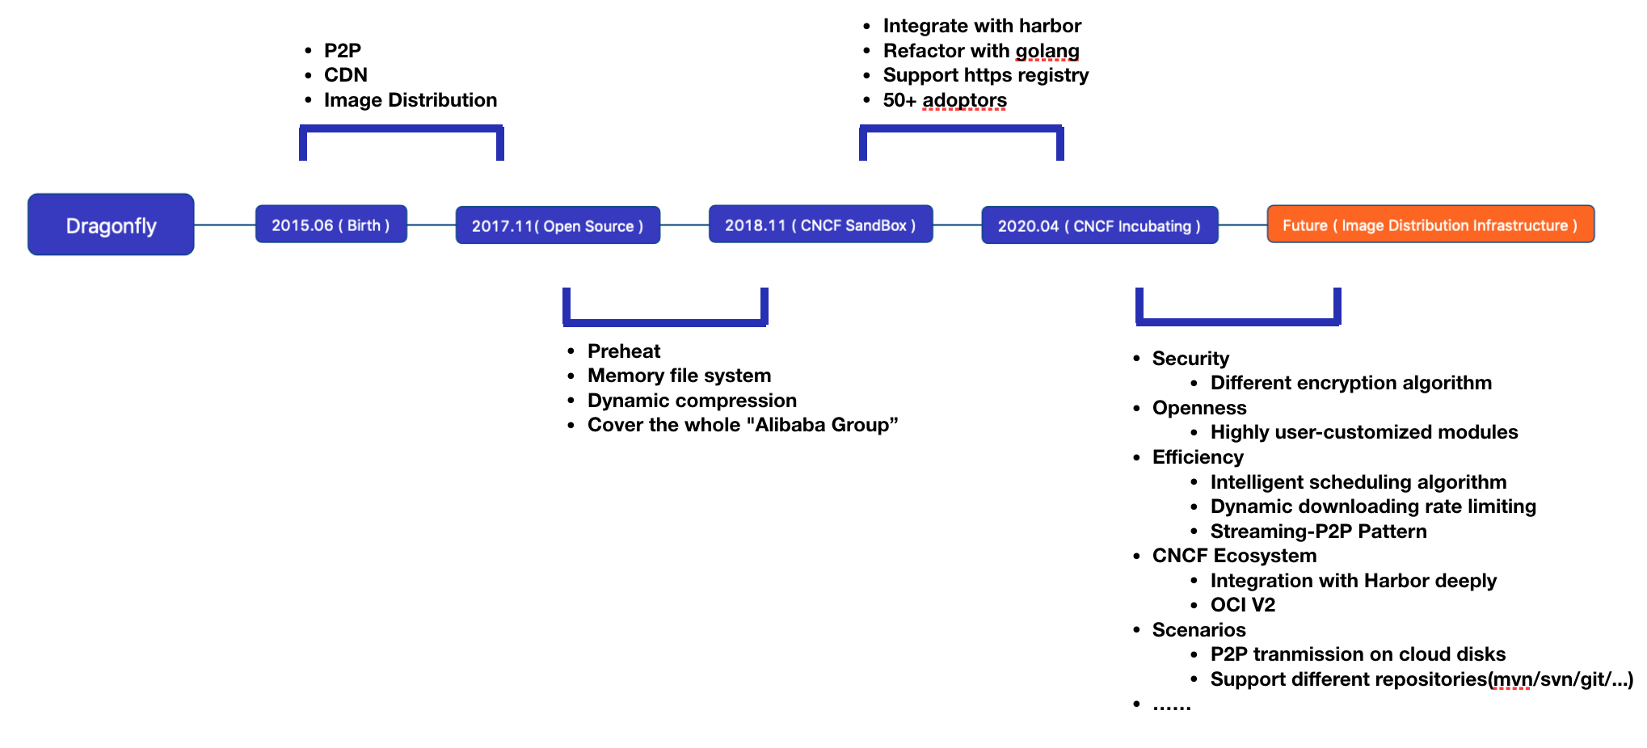
Milestone

Slide 6
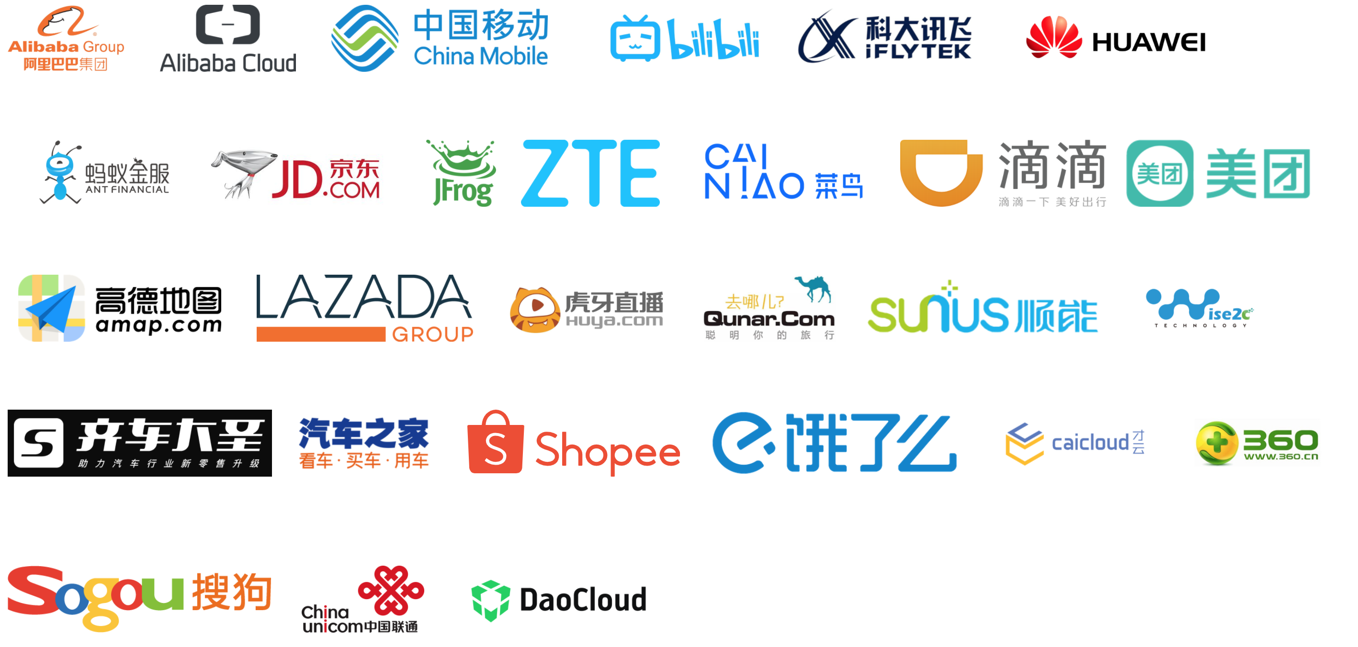
Community Situation
CNCF incubating stage
5200+ GitHub Stars
70+ Contributors
8 maintainers across 4 companies
50+ adoptors

Slide 7
PART TWO
Arch
02

Slide 8
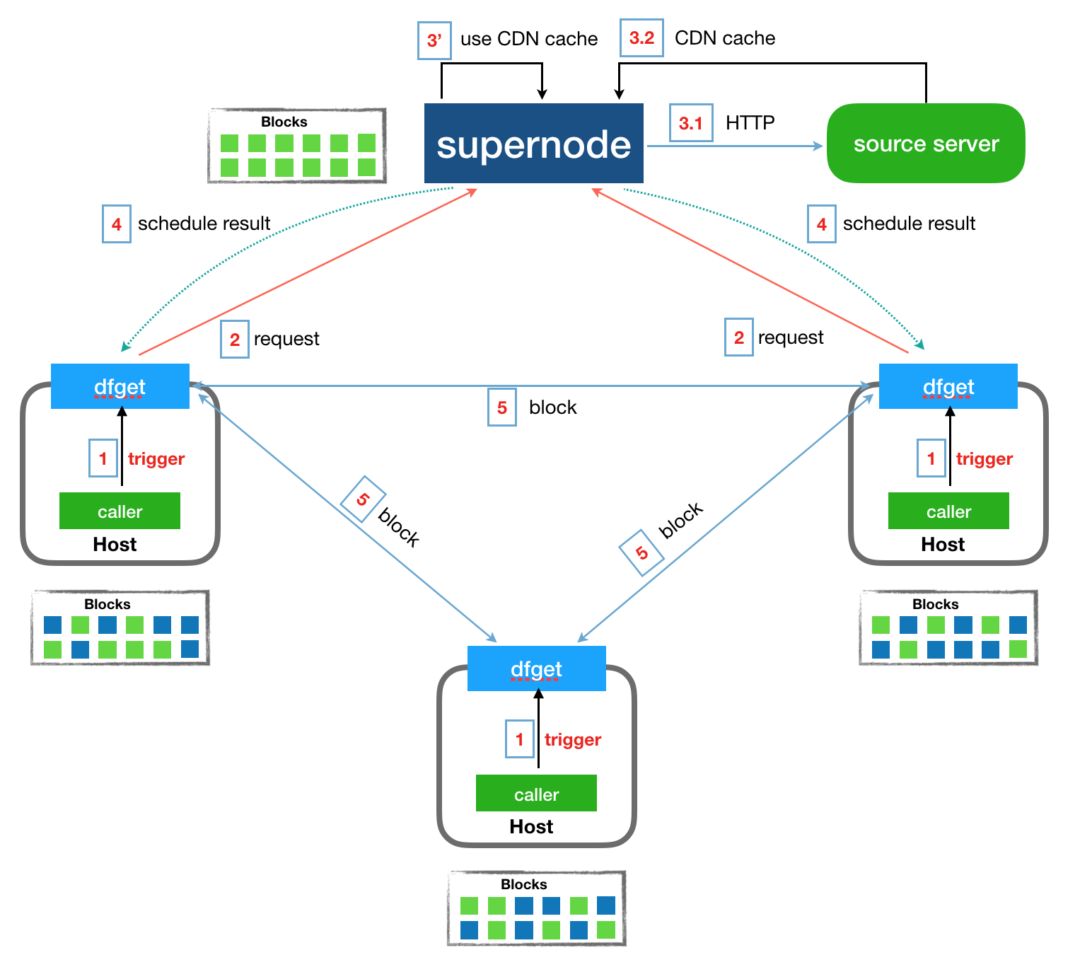
P2P & CDN Mechanism
Trigger download files with Dragonfly
Send download requests to supernode
Use CDN cache or cache files from source server if non-exist
Reply to node peers which have blocks
Transport blocks among all peers
All nodes complete the download of all blocks

Slide 9
Participles in pulling images
Manifest: a JSON document which defines an OCI image, such as layers, size, and digest.
Layer: the binary form of content that is stored by a Registry, addressable by a Digest
Process of pulling an image :
Retrieve the manifest ( GET /v2/<name>/manifests/<reference> )
Verify the returned manifest signature ( HEAD /v2/<name>/manifests/<reference> )
Pull layers which are not exist ( GET /v2/<name>/blobs/<digest> )

Slide 10
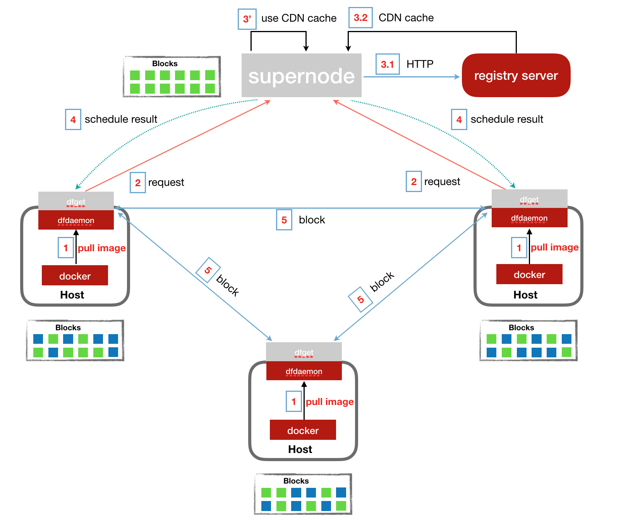
Participles in pulling images
Pull image with node proxy(dfdaemon)
Download an image layer with P2P mechanism
Get a complete OCI image

Slide 11
Participles in pulling images
Configure the container engine to use Dragonfly :
Docker HTTP(S) PROXY
[Service]
Environment="HTTP_PROXY=http://127.0.0.1:65001" Environment="HTTPS_PROXY=http://127.0.0.1:65001"
Containerd CRI Registry Mirrors
[plugins.cri.registry.mirrors]
[plugins.cri.registry.mirrors."docker.io"]
endpoint = ["https://registry-1.docker.io"]
[plugins.cri.registry.mirrors."test.secure-registry.io"]
endpoint = ["https://HostIP1:Port1"]
[plugins.cri.registry.mirrors."test.insecure-registry.io"]
endpoint = ["http://HostIP2:Port2"]
……

Slide 12
PART THREE
Nydus Image Service
03

Slide 13
OCI Image Drawbacks
Before starting a container, images must be pulled and decompressed to the local filesystem
Deduplication at layer level is less efficient
https://hackmd.io/@cyphar/ociv2-brainstorm
Notes:
Metadata only modification would cause the file data to be saved again in the new layer
Files modified in multiple layers are downloaded multiple times while only the last modified file data is actually useable for containers
Deleted files/directories are still downloaded when pulling an image

Slide 14
Community Prior Works
P2P based fast image distribution
Dragonfly -- CNCF
Kraken -- Uber
File level local cache
CernVM-fs -- CERN
Rely on storage layer snapshot capability
Slacker -- University of Wisconsin
Hack gzip stream, keeping layering layout
CRFS -- Golang Build Team
Split metadata/data, breaking layering layout
Filegrain -- NTT
Umoci -- SuSE

Slide 15
Nydus Image Service
Container images are downloaded on demand
Files are split into chunks with chunk level data deduplication
Flatten image metadata and data to remove all intermediate layers
End-to-end image data integrity
Compatible with the OCI artifacts spec and distribution spec

Slide 16
Nydus Architecture

Slide 17
Nydus Image Format

Slide 18
Container Startup Time

Slide 19
End-to-end Data Integrity

Slide 20
Future Work
Better integration with the container image ecosystem
Support more compression algorithms
Flexible chunk size
Flexible deduplication levels
Serve as a reference implementation to the OCIv2 image spec
website: https://github.com/dragonflyoss/image-service

Slide 21
Dragonfly FAQ
Official Website : https://d7y.io/
Github: https://github.com/dragonflyoss/Dragonfly
Twitter: @dragonfly_oss
DingTalk Group: 23304666

